Slide 1

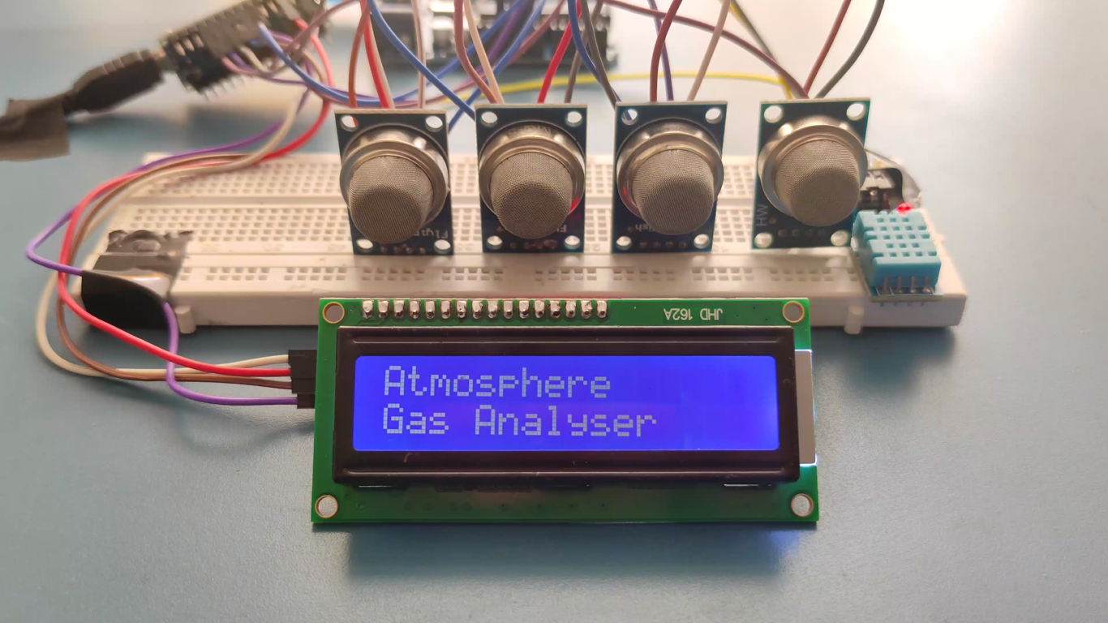
Cloud Based Air Pollution Detector
ECE 3100
Electronic Shop Practice

Slide 2



Our Team
Project Overview
Resources
Progress till now
Circuit from Top View
Circuit View on Proteus
Project Demonstration
Statistics
Frontend of Website for statistics
Outlines

Slide 3




Our Team Members
Promit Biswas
Roxy Sarkar
1810039
1810040

Slide 4
Project Overview
1
It is portable air pollution detector that helps to find out the different air substances level in any specific area and predict future situation and show on a website.
2
It will detect the amount of AQI, CO, Methane, Butane, CO2, Humidity and temperature appeared in the air.
3
It will be alarmed when it detects the excessive amount of harmful gases.
The amount of gas particles will be displayed in LCD display.
4
5
It will transfer data to Online Cloud based Website to show data in different times to predict the occurrence.

Slide 5
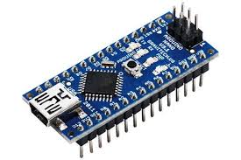
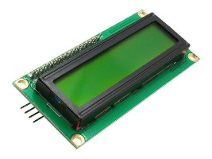
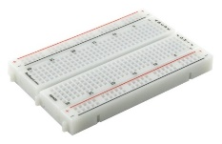
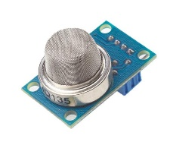
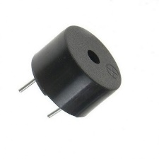
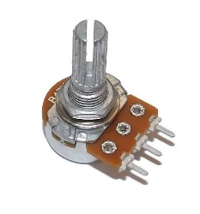
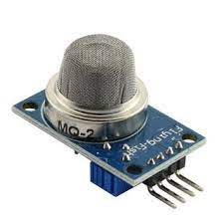
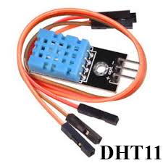
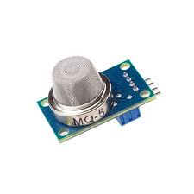
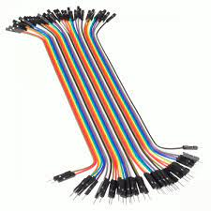
The Resources we used:
Arduino Nano
MQ-135 Gas Sensor
Buzzer
MQ-2 Gas Sensor
MQ-5 Gas Sensor
LCD Screen
Project Board
Potentiometer
DHT11 Temperature & Humidity Sensor
Wires
Resources

Slide 6

Project can individually detect CO, CO2, Smoke, Humidity, Natural gas, LPG.
Progress
Till Now
This Project can show the Air Substance in PPM values in LCD Display.
READ MORE
This Project can say which ppm is good bad or harmful in display with warning.

Slide 7
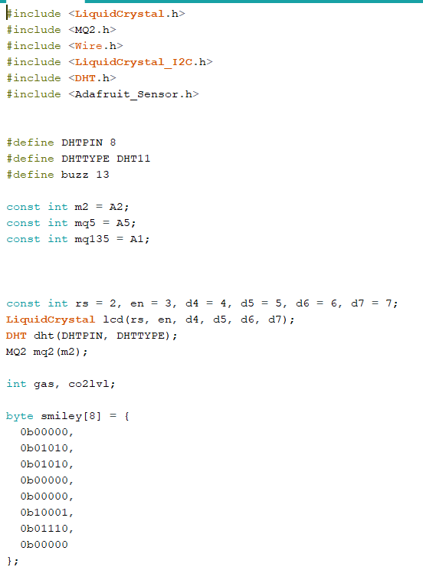
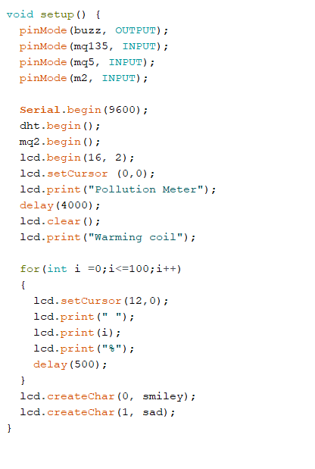
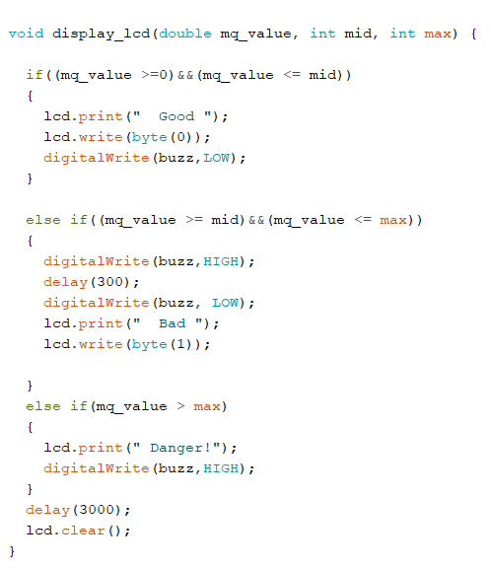
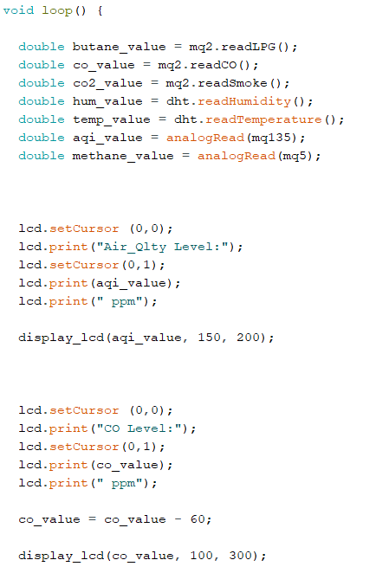
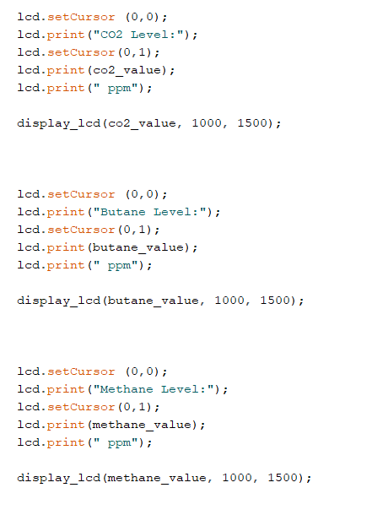

Codes

Slide 8
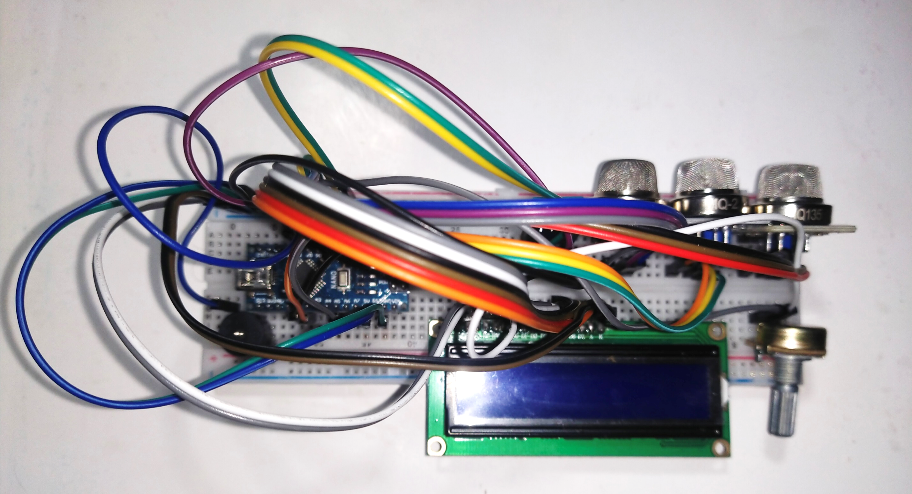
Circuit From Top

Slide 9
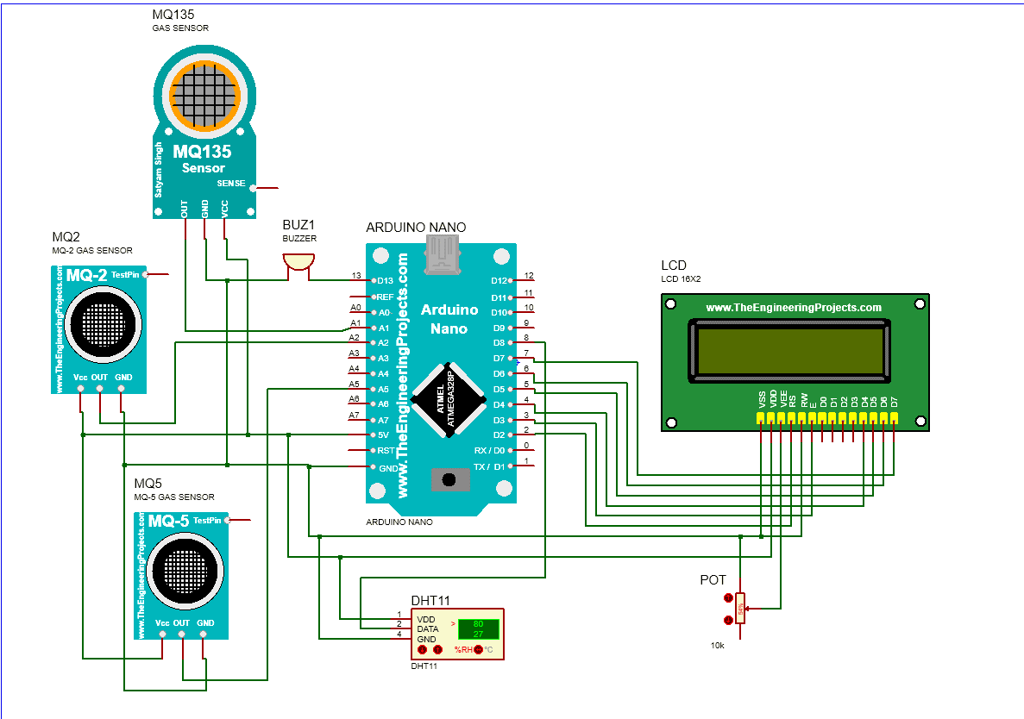
Circuit
Diagram
On
Proteus

Slide 10
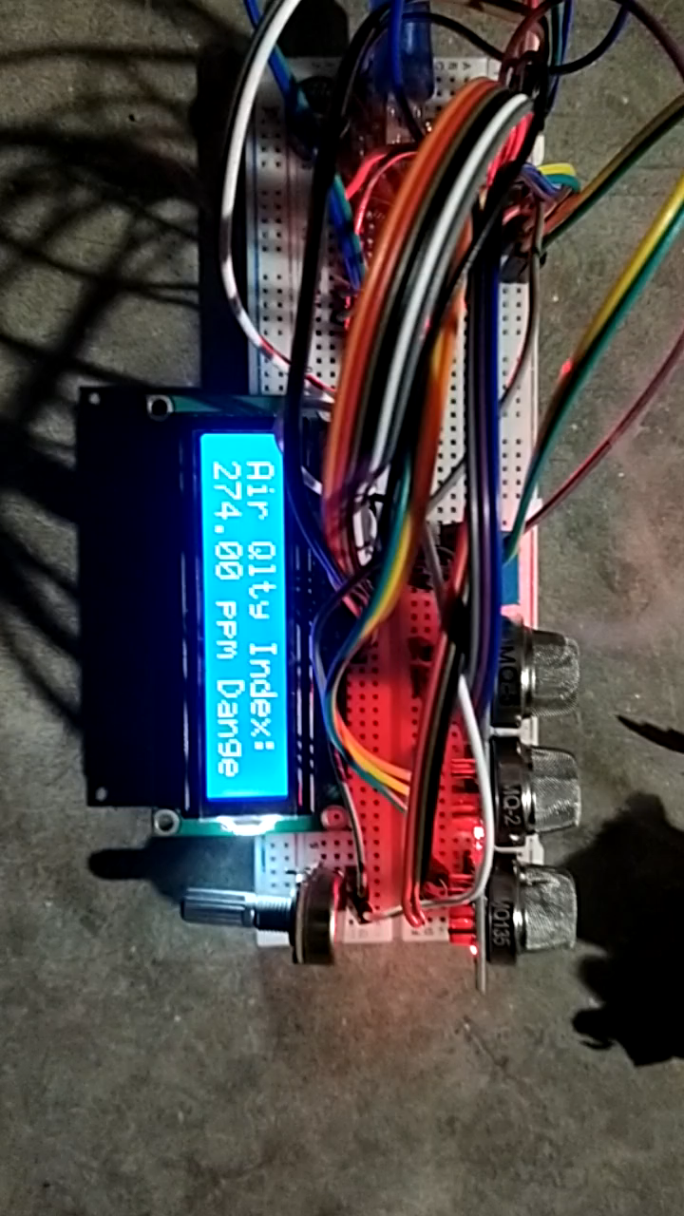
Project Demonstration

Slide 11


Statistics
Levels of Substance
Normal Air
With Gas
Burning Papers & Mosquito Coil
AQI
86 PPM
196 PPM
274 PPM
CO
9 PPM
733 PPM
2018 PPM
CO₂
6 PPM
195 PPM
429 PPM
Methane
47 PPM
73 PPM
100 PPM
Butane
1 PPM
43 PPM
89 PPM
Temperature
31 ℃
30.50 ℃
33.70 ℃
Humidity
78%
84%
77%
Table of Different Substance

Slide 12
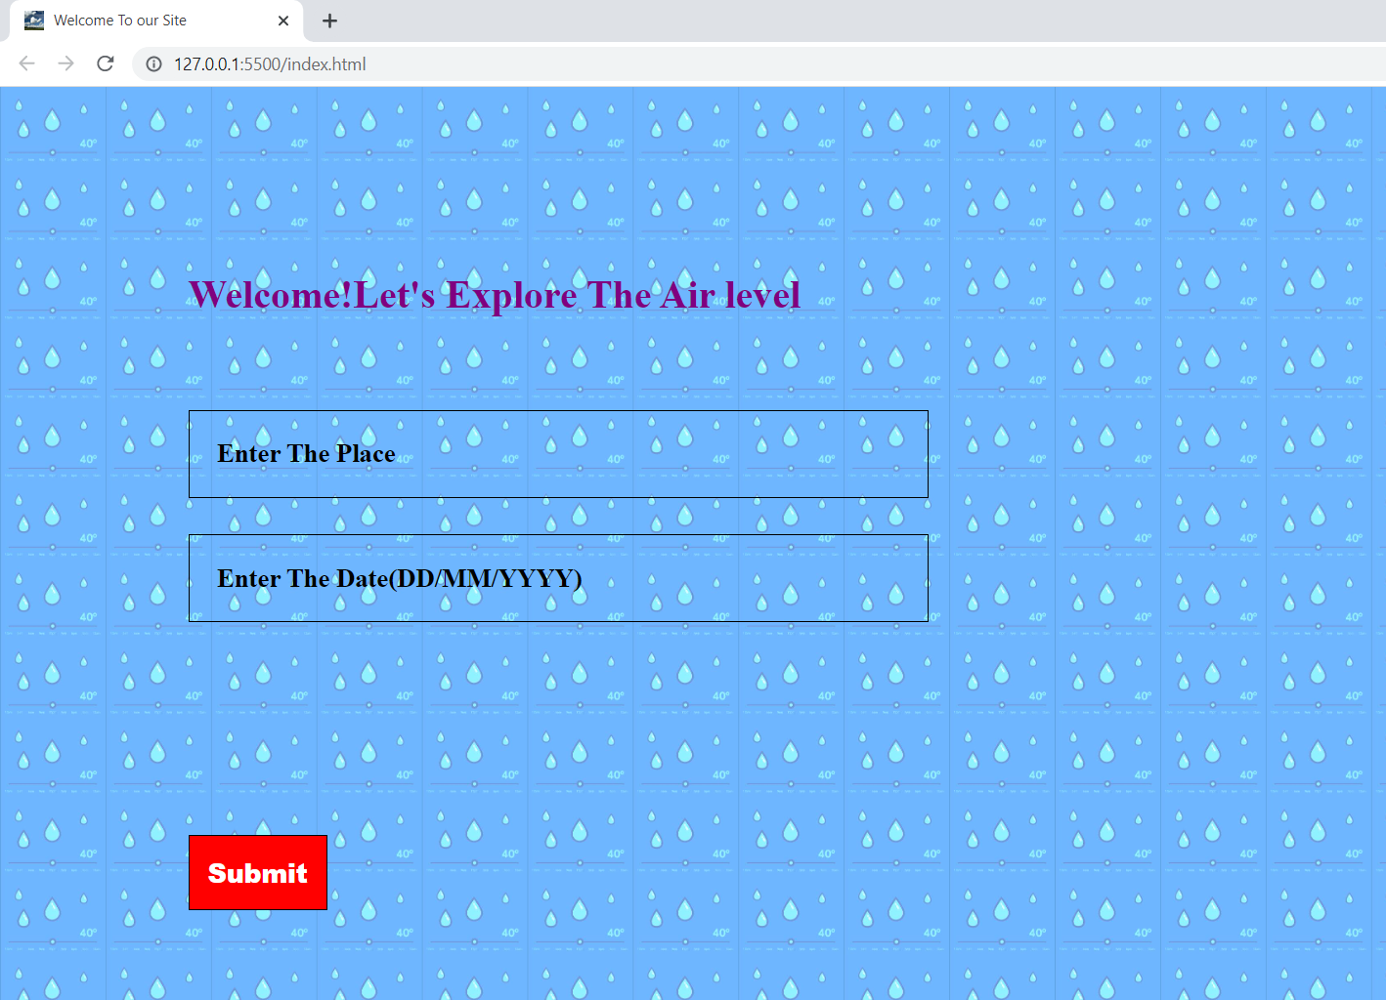
FrontEnd
WebView
For
Statistics

Slide 13


Future Scopes
The data collected from any area like RAJSHAHI by this device, will be stored in the cloud.
We will use Bluetooth module to send data to mobile application. From that a text file will be generated automatically and will be uploaded to our website to predict data.
Through the collected data set, by the help of statistics we can forecast about the weather of the specific area and important decisions can be taken on the basis of the collected data and the drawn graph.

Slide 14

Any Questions?

Slide 15


Thank You
FOR THE ATTENTION

